Slide 1
ECE 333
Green Electric Energy
Hydro and Wave Power
Dr. Karl Reinhard
Dept. of Electrical and Computer Engineering
University of Illinois at Urbana-Champaign
reinhrd2@illinois.edu

Slide 2
Announcements
Reading Chapter 8 – More Renewable Energy Systems
  Wave energy conversion
  Hydroelectric
  Pumped-storage Hydro
HW 9 will be covered during an in-class Quiz 9 on 19April
Final Exam is Tuesday 8 May, 8 to 11 am

Slide 3
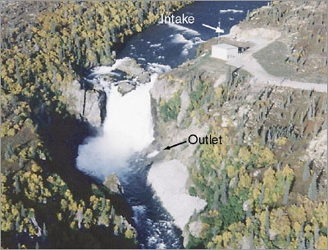
Types of Hydro
Diversion (also known as run-of-river)
  Some of the water is
  channeled into a canal
  or penstock and through
  the turbine
  It will tend to have little
  or no storage; the energy
  associated with water that
  is not diverted is lost
  Because there is no need
  to build a dam, diversion hydro often has less environment impact
Image: http://energy.gov/eere/water/types-hydropower-plants

Slide 4
Types of Hydro
Pumped Storage
  Uses the potential energy of water to "store" electricity
  Part of the time it works as a conventional impoundment hydro plant with water in a high reservoir flowing through the turbine to a lower reservoir (or lake/river)
  Part of the time it functions as a large load as water is pumped from the lower reservoir back to the higher reservoir
  Works as a generator when the price of electricity is high (e.g., during the day) and as a load when price of electricity is low (e.g., during the night)
  Round trip efficiency can be up to 80%

Slide 5
Hydro Power – 2006
(Most Widely Used Renewable Resource)
http://www.eia.doe.gov/emeu/international/RecentElectricityGenerationByType.xls
Hydro power is the most widely used renewable resource in the world.
U.S. 2.9 quad (billions of kWh);
  ~ 3% of total energy,
  ~ 9% of total electricity.
Worldwide hydro (2006) (billion kWhs, % energy demand):
  Canada (352, 59%),
  Brazil (345, 84%),
  Norway (118, 98%),
  China (431, 16%),
  South America is about 2/3 hydro (639.6/951.0)
  Worldwide (2998, 16.6%)
Notes:
4

Slide 6
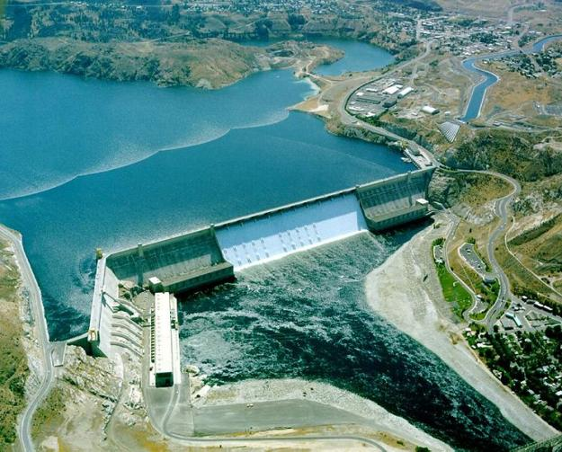
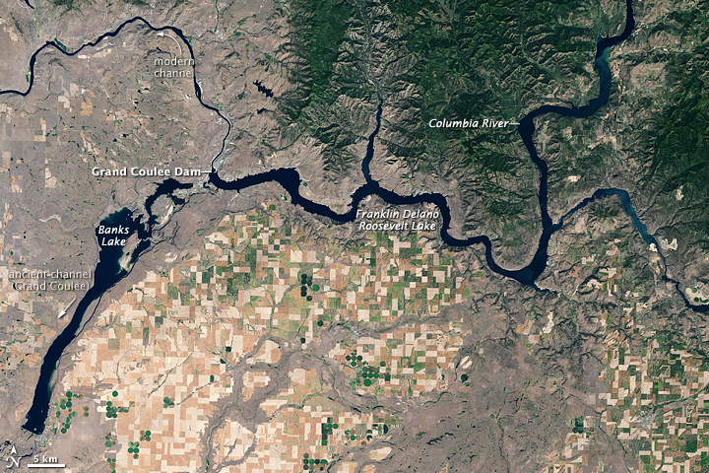
Largest Hydro US: Grand Coulee, WA
Largest hydro power station is US is on the Columbia River in Washington State. It was opened in 1942, and now has a total capacity of 6.8 GW
  Hydraulic head is 380 feet; reservoir size is 125 sq miles
http://en.wikipedia.org/wiki/Grand_Coulee_Dam
Notes:
5

Slide 7
Lighting Africa, Grand Inga, DR Congo
Africa’s 2006 Total electric consumption was 547 TWh,
(less than Canada’s 594 TWh)
South Africa (228 TWh) and Egypt (109 TWh)
→ 257 TWh for 800M remaining people, a value of
~ 321 kWh per capita, → 37 watts average consumption
  Note, this value includes industrial, commercial and residential consumption
  Total electric capacity in Africa (excepting South Africa and Egypt) is less than 60 GW, about 1/3 of which is hydro
  Yet Africa has hydro electric capacity of 100’s of GW
Notes:
6

Slide 8
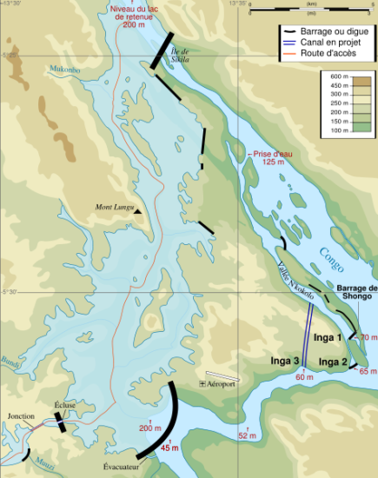
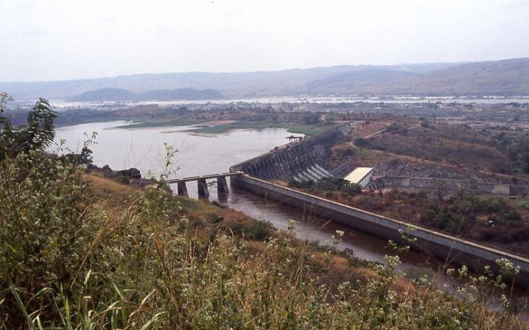
Lighting Africa: Grand Inga, DR Congo
Hydro at the Inga dams in Congo (on Congo River)
  1.8 GW current capacity,
  >> 40 GW potential capacity, w/ 370 TWh annual energy production !
Notes:
7

Slide 9
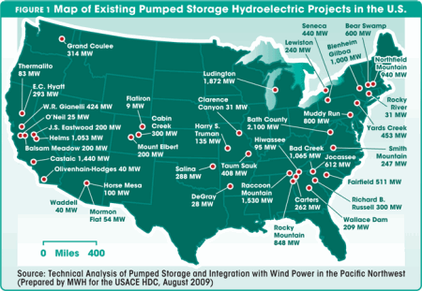
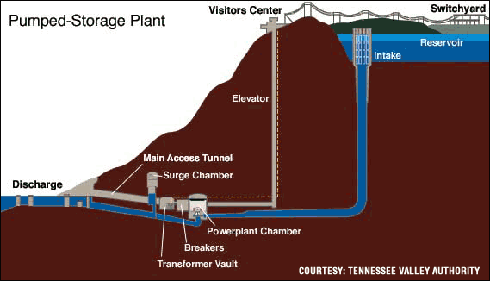
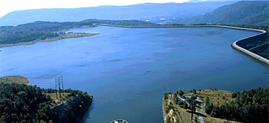
Pumped Storage Example
Total installed U.S. capacity ~ 16,500 MW
Example: Raccoon Mountain – 650 MW
  stores ~ 20 hours of water flow;
  fills in 28 hours;
  water levels change 100 ft
http://www.ferc.gov/industries/hydropower/gen-info/licensing/pump-storage/diagram-pump.asp
http://www.hydroworld.com/content/dam/etc/medialib/new-lib/hydroreview/print-articles/volume-30/issue-2/48198.res/_jcr_content/renditions/pennwell.web.450.311.gif

Slide 10
Useful Conversions for Water
Water has potential energy (mgh), kinetic energy
(½mv²) and pressure energy (mgh → noncompressible)
 | American | SI
1 ft³ | 7.4805 gal | 0.02832 m³
1 ft/ second | 0.6818 mph | 0.3048 m/s
1 ft³/second | 448.8 gpm | 0.02832 m³/s
Water density | 62.428 lb/ft³ | 1000 kg/m³
1 psi | 2.307 ft of water | 6896 N/m²
1 kW | 737.56 ft-lb/s | 1000 N-m/s
Use this to find the potential power available given a head H_{N} and a flow rate Q
Note, pounds is a unit of force; 1 slug = 14.6 kg (32.2 lbs at one g)

Slide 11
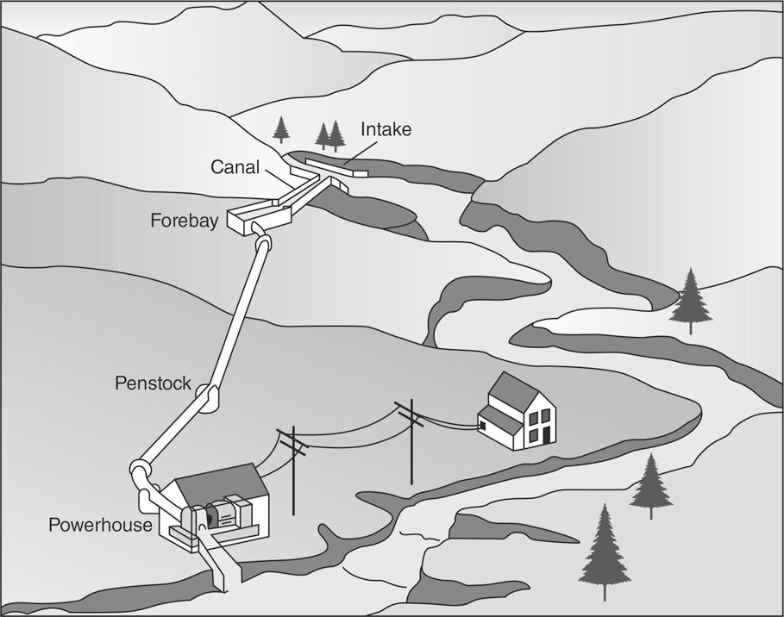
Micro Hydro (less than 100 kW)
    FIGURE 8.30 A micro-hydropower system in which water is diverted into a penstock and delivered to a powerhouse below.
    Masters, Gilbert M. Renewable and Efficient Electric Power Systems, 2nd Edition. Wiley-Blackwell, 21/06/2013.
Notes:
10

Slide 12
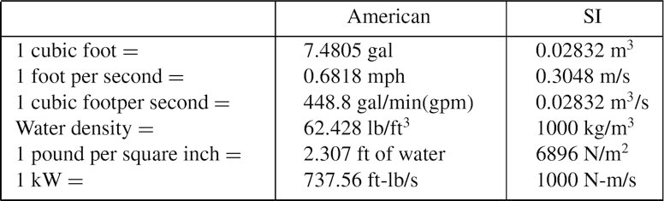
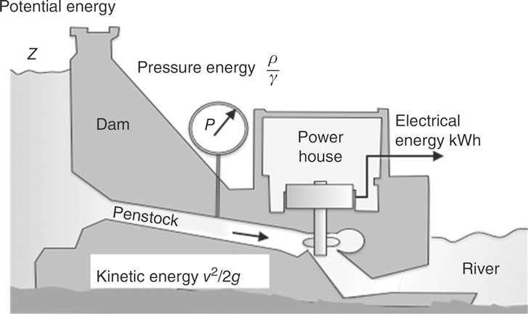
    FIGURE 8.31 Transformations of energy in a hydroelectric system.
    Masters, Gilbert M. Renewable and Efficient Electric Power Systems, 2nd Edition. Wiley-Blackwell, 21/06/2013.

Slide 13
    Table. 8.10 Useful Conversions for Water
    Masters, Gilbert M. Renewable and Efficient Electric Power Systems, 2nd Edition. Wiley-Blackwell, 21/06/2013.
    Fig. 8.31 Transformation of Energy in a hydroelectric system.
    Masters, Gilbert M. Renewable and Efficient Electric Power Systems, 2nd Edition. Wiley-Blackwell, 21/06/2013.

Slide 14
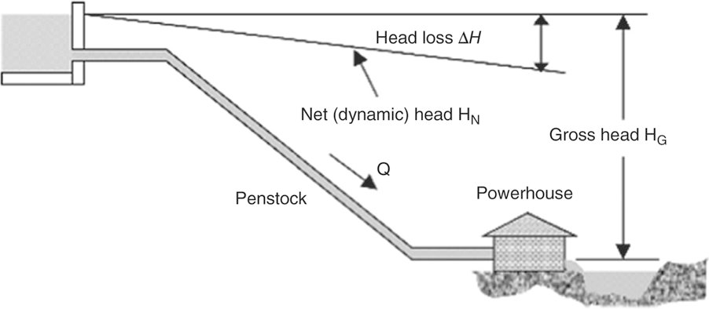
Pipe Head Loss
    FIGURE 8.34 Net head is what remains after pipe losses are accounted for.
    Masters, Gilbert M. Renewable and Efficient Electric Power Systems, 2nd Edition. Wiley-Blackwell, 21/06/2013.
Notes:
13

Slide 15

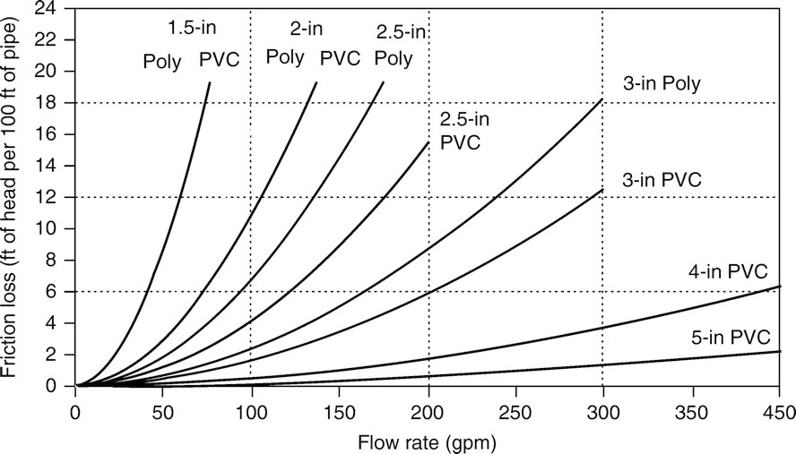
Head Loss from Pipes
    FIGURE 8.35 Friction head loss, in feet of head per 100 ft of pipe, for 160-psi PVC piping and for polyethylene, SDR pressure-rated pipe.
    Masters, Gilbert M. Renewable and Efficient Electric Power Systems, 2nd Edition. Wiley-Blackwell, 21/06/2013.
Notes:
14

Slide 16
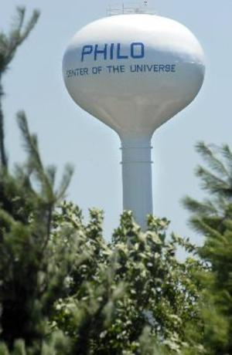
Water Tower Example
How much energy is in a 500,000 gallon water tower with an average height of 200 ft (60.9 m)?
Mass of water
Energy
250,000
gallons in
the Philo,
IL tower

Slide 17
Water Tower Example, cont’d
What is the equivalent pressure head?
Specific weight
units are either
lb/ft³ or N/m³
specific weight of water

Slide 18
Micro Hydro Setup
Potential Energy
Reservoir
z
Pressure
Penstock
Kinetic Energy
Turbine
At top- gross head (H_{G}) = z [feet]
At bottom- net head (H_{N})
Losses- H_{L}=H_{G}-H_{N} [feet]

Slide 19
Pipe Losses
A 4’’ pipe delivers 150 gallons/minute (gpm) through an elevation change of 100 ft. Pressure at pump house is 27 psi. What are pipe losses?
Total head is 62.51 ft
Head loss: 100 – 62.5 = 37.49 ft

Slide 20
Power Theoretically Available
Need to convert units to get power in kW
Since the conversion factors are always the same, we can simplify to
The dependence of on Q and H is the same regardless of whether high flow, low height or low flow, high height

Slide 21
Hazen-Williams Loss Equation
Empirical frictional head loss calculation
Q = flow rate [gal/min]
L = length of pipe [ft]
D = diameter of pipe [in]
C = roughness coefficient (PVC = 150; corrugated steel = 60; smooth steel, cement = 130 to 140)
Book approximation for fixed pipe size:

Slide 22
Salt Fork River Example
How much power is in the Salt Fork River?
  100 ft³/sec, 7.48 gal/ft³, 3.78 liter/gallon
Assuming
1 m/s velocity
Equivalent head:
Note, the real-time flow for the Salt Fork (at St. Joseph) is available at http://waterdata.usgs.gov/nwis/uv?03336900
4/17/18 Flow rate was ~ 361 cubic feet/second; max is about 9000 cubic feet/second.
Congo is 1.5 million cubic feet per second while Amazon can reach 11 million cubic feet per second! Grand Inga power estimate = (1.5e6*60*7.48*450)/5.3 = 57GW

Slide 23
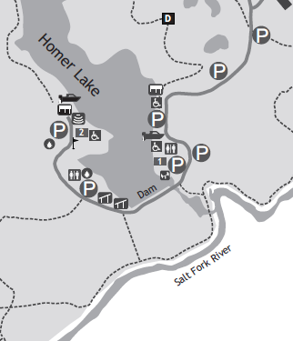
Homer Lake Hydro Example
80 acres, 30 ft head, say we get 4488 gal/minute out, and capacity factor is 100%
What is power/energy impact for 100 ft of 10” vs. 12” pipe?
10”
Hazen-Williams
Loss Equation
Efficiency η is 50%:
Capacity factor is 100%:
image: http://www.ccfpd.org/about/Map_HL_final_vert_042010.pdf

Slide 24
Homer Lake Hydro Example
Assume an efficiency η of 50% and a capacity factor of 100%
12”
http://www.ccfpd.org/about/Map_HL_final_vert_042010.pdf

Slide 25
Optimal Flow Rate
Suppose the pipe diameter is fixed
However, a larger diameter will always lower losses
(optimal)
low loss, low P
high loss, low P
P(W)
Q (gpm)
Theoretical maximum flow and therefore power is delivered by a pipe when losses are equal to 1/3 of the gross head

Slide 26
Turbine Design - 3 Approaches
1. Impulse turbines
- most common for micro-hydro systems
- capture kinetic energy of high-speed jets
- high head, low flow
2. Reaction turbines
- pressure difference of blades creates a torque
- low head, high flow
3. Waterwheel
-slow-moving but powerful
- converts potential energy to mechanical energy

Slide 27
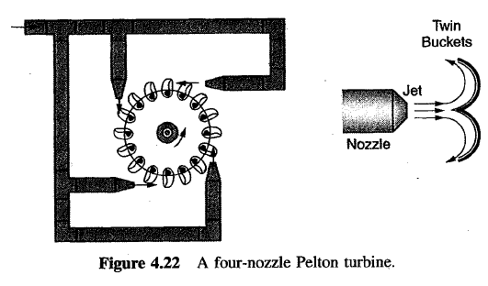
Impulse Turbine Example: Pelton Wheel
The original impulse turbine by Lester Pelton in 1870's
Water flows from nozzles onto sets of buckets attached to the rotating wheel
Uses velocity of water, with no down side suction

Slide 28
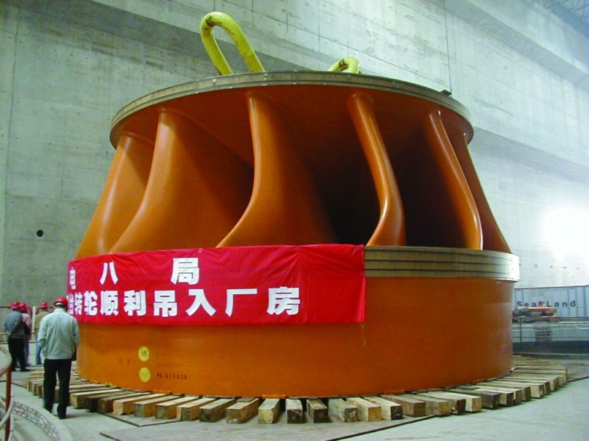
Reaction Turbines
Develops power from combined action of the pressure and moving water
Placed directly in the stream of flowing water; better for locations with low head and high flow
Examples: Francis Turbine,
invented by James Francis
in 1848
Image at left shows example
from Three Gorges
Full output in 2012; 98.8
TWh in 2014; US total 259 TWh
http://en.wikipedia.org/wiki/Francis_turbine#/media/File:Sanxia_Runner04_300.jpg

Slide 29
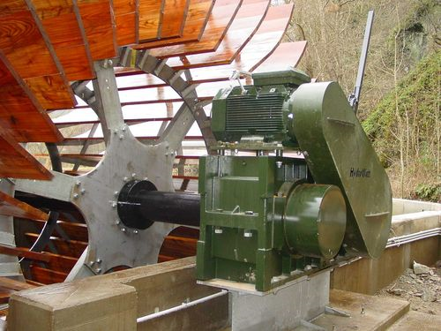
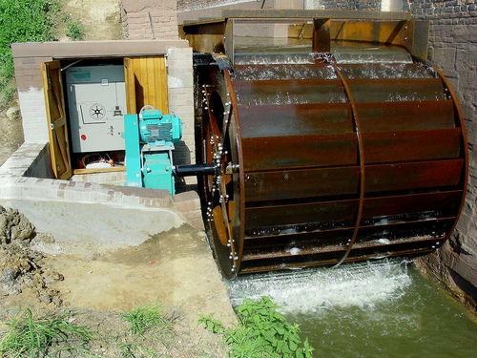
Waterwheels
Not very efficient, but can be considered for micro hydro situations in which the head is low
Relatively simple to install
Often viewed as aesthetically pleasing
http://www.british-hydro.org/waterwheels.html

Slide 30
Wave Power
The potential energy available waves is quite high, with
some estimates up to 2 TW (2000 GW) worldwide.
The potential wave power per meter varies with the square of the wave height and linearly with the period
  Three meter waves with an 8 second period produces about
  70.5 kW/m, while 15 meter waves with a 15 second period produces about 3.3 MW/m
Density of sea water, ρ, is 1025 kg/m³ (give or take);
g (gravity) is 9.8 m/s² ;
H is wave trough-crest height; and
T is period

Slide 31
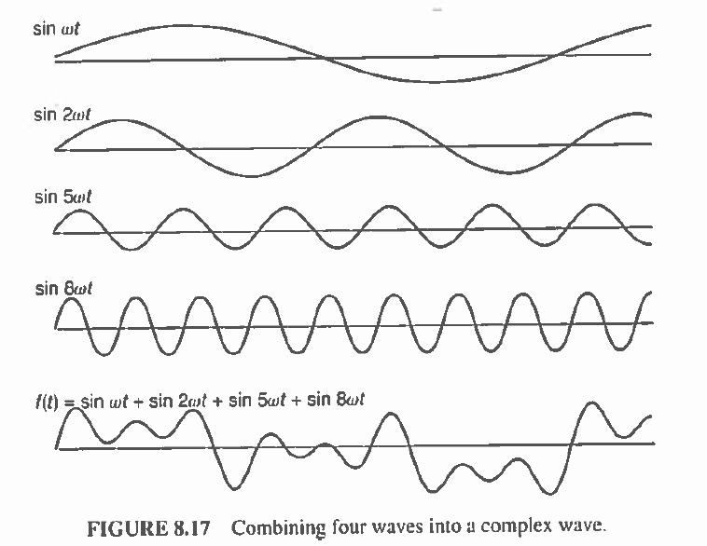
Wave Power
Waves are more complex, consisting of a number of superimposed frequencies
A common
way to
estimate
power is to
just count the
heights of the
highest 1/3 of
the waves,
H_{1/3}

Slide 32
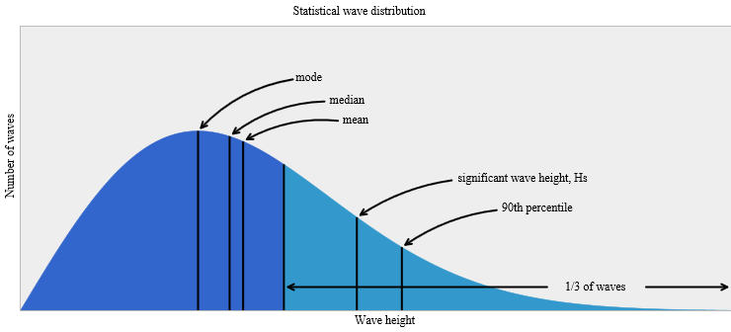
Significant Wave Height
The significant wave height, H_{s}, assumes a Rayleigh statistical distribution on the wave heights
Then T_{p} is associated
with an assumed
distribution of the
wave periods
Then the power is
H_{s} and T_{p} data is available for many locations
Image source: http://upload.wikimedia.org/wikipedia/commons/8/87/Wavestats.svg

Slide 33
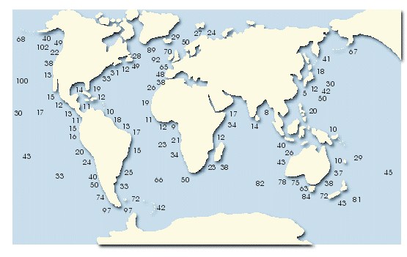
Annual Average Wave Power (kW/m)
Source://www.energy.ca.gov/2006publications/CEC-500-2006-119/CEC-500-2006-119-D.PDF

Slide 34
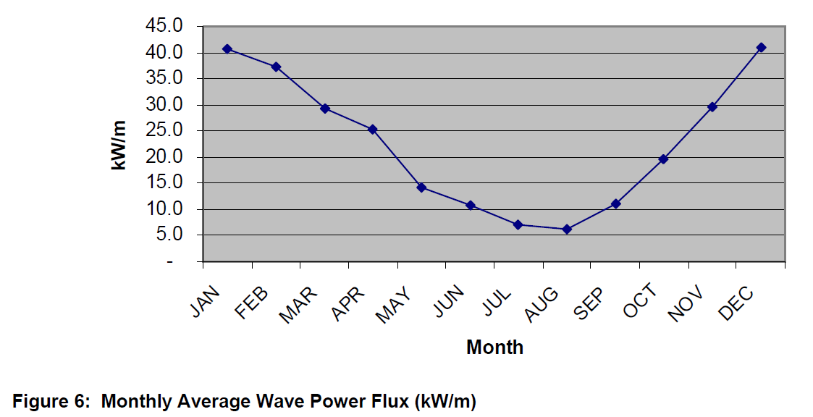
There Can Be Significant Seasonal Variation
Figure shows data for a site by Oregon; just like for other energy sources, capacity factors come into play
CF values
tend to
be no
more
than
30%
http://oceanenergy.epri.com/attachments/wave/reports/Ph_15_Oregon_Wave_Final_RB_121305.pdf

Slide 35
Wave Energy Conversion Technologies
Industry is in infancy, so different technologies are being considered
  More than 1000 have been patented!
Creating durable, economic devices is challenging!
Design is partially driven by location
  Close to shore: easier to maintain, close to utility, waves coming in fixed direction, smaller waves so conditions less extreme; but wave power is less; tidal issues could also be a concern
  Offshore are in deeper water and subject to more extreme conditions; but wave power is higher and tidal issues are less; wave directions more variable

Slide 36
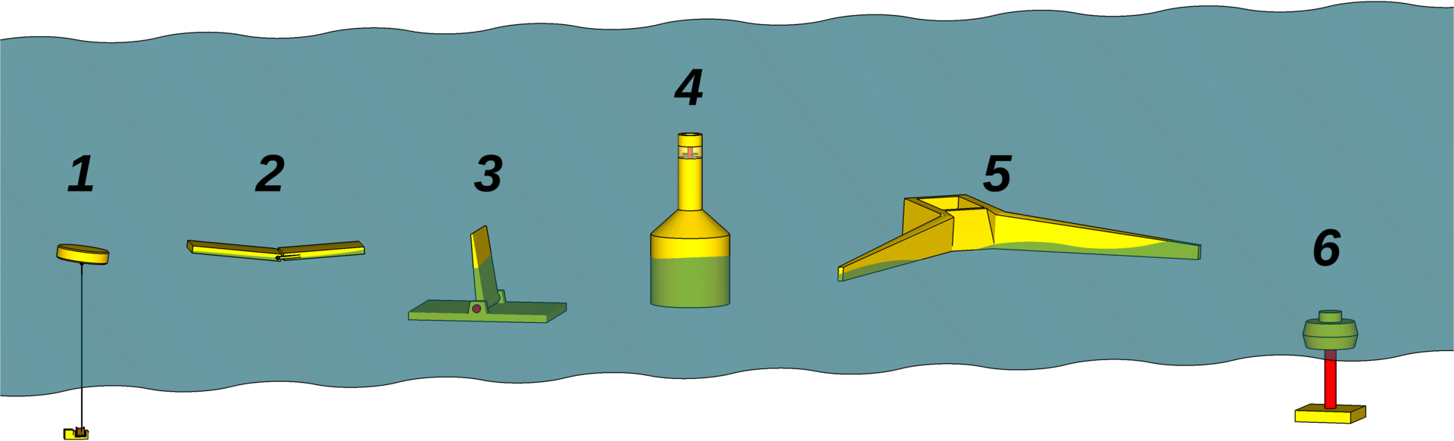
Wave Energy Conversion Technologies
Major design technologies
  (1) Point absorber buoy: buoy goes up and down to drive pumps to generate electricity
  (2) Surface attenuator: device flexes as waves go by, driving pumps that generate electricity
  (3) Oscillating wave surge: one end fixed, the other is free to
  move; energy collected from relative motion
Source: http://en.wikipedia.org/wiki/Wave_power

Slide 37
Wave Energy Conversion Technologies
  (4) Oscillating water column: waves compress air, which is used to generate electricity
  (5) Overtopping device: wave velocity used to fill a reservoir, with energy captured by low head turbines
Source: http://en.wikipedia.org/wiki/Wave_power

Slide 38
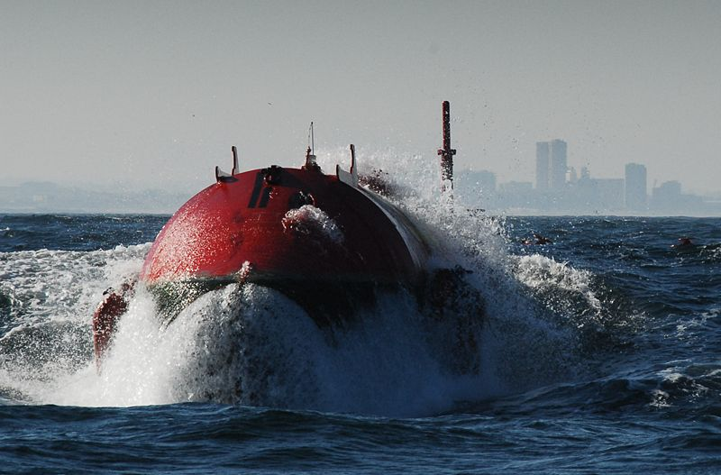
Wave Power
World’s largest wave park” was the Agucadoura Wave Farm in Portugal, with capacity of
2.25 MW
Each of three devices was 142m long, and has a diameter of 3.5 m, and uses 700 metric tons of steel
Surface attenuator design, using high pressure oil
Capacity factor seemed to be about
20%
In-service for less than one year
(2008)

Slide 39
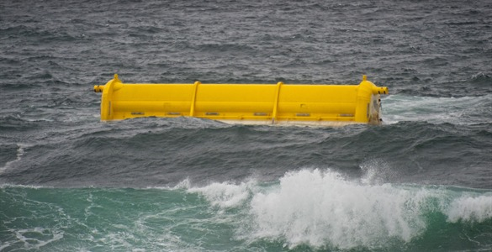
Oyster 800 Wave Energy Machine
Device is 26 m in width, installed at a depth of 13 m, about 500 m from shore; can produce 800 kW
  Located by Orkney, Scotland, UK
Company (Aquamarine Power) claims three benefits: simplicity, survivability, and shore-based
Unit has operated for
20,000 hours; 70% of |
energy is from October
to March; overhaul
during summer
http://www.aquamarinepower.com/projects/oyster-800-project-orkney/
https://www.youtube.com/watch?v=fCheEfaoCOs

